Slide 1
Proc SQL in SAS
By: Meisam Hejazinia
Class of Data Analysis of Professor B.P.S. Murthi @ UTD
Winter 2013

Slide 2
Relational Databases
Data is represented in the form of tables, and the model has 3 components
Data structure:
data are organised in the form of tables with rows and columns
Data manipulation:
powerful operations (using the SQL language) are used to manipulate data stored in the relations
Data integrity:
facilities are included to specify business rules that maintain the integrity of data when they are manipulated

Slide 3
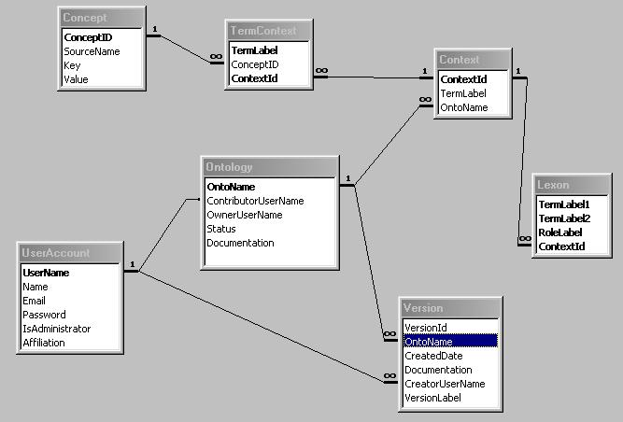
Example

Slide 4
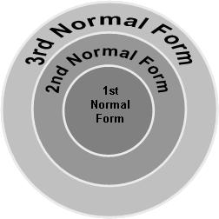
Normalization rules
First Normal Form (1NF): sets the very basic rules for an organized database
Eliminate duplicative columns from the same table
Create separate tables for each group of related data and identify each row with a unique column (the primary key)
Second Normal Form (2NF)
Remove subsets of data that apply to multiple rows of a table and place them in separate tables.
Create relationships between these new tables and their predecessors through the use of foreign keys.
Third Normal Form (3NF)
Remove columns that are not dependent upon the primary key.

Slide 5
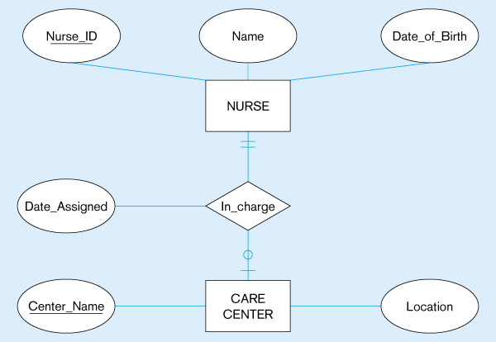
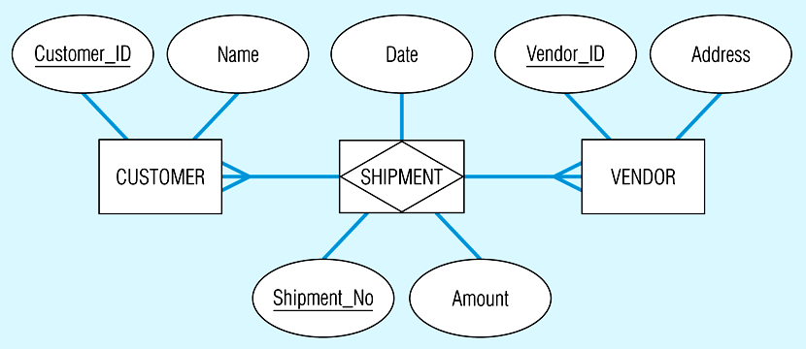
Entity Relationship Diagram
Steps:
First: map regular entities: transform to relation
Second: Map weak entities
Can not be identified by its attribute
Needs foreign key in conjunction with primary key as a primary key
Third:
Map binary relations
Fourth:
Map associative entity

Slide 6
SQL
SQL: Structured Query Language
Attempts to allow humans to ask questions of data sources using natural language
retrieves and updates data in tables and views based on those tables
The SAS System's SQL procedure enables you to
retrieve and manipulate data that are stored in tables or views.
create tables, views, and indexes on columns in tables.
create SAS macro variables that contain values from rows in a query's result.
add or modify the data values in a table's columns or insert and delete rows. You can also modify the table itself by adding, modifying, or dropping columns.
send DBMS-specific SQL statements to a database management system (DBMS) and to retrieve DBMS data.

Slide 7
Format of SQL command
SELECT
FROM
WHERE
GROUP BY
HAVING

Slide 8
Example: Simple selection, create table
PROC IMPORT OUT= TLCM.STATUS9104
DATAFILE= "C:\..\9104status.csv"
DBMS=CSV REPLACE;
GETNAMES=YES;
DATAROW=2;
RUN;
PROC SQL;
CREATE TABLE TLCM.CalldetailAAge AS
SELECT Anumber,Bnumber, APChurncall,BPChurncall,AGE AS AAGE
FROM TLCM.Calldetailjtb A, TLCM.Age B
WHERE A.Anumber=B.MSISDN
/*ORDER BY calldate */
;
QUIT;

Slide 9
Example: Query
/**
Find those records with 2 or more ‘B' status and print the counts
******/
PROC SQL PRINT;
SELECT
id,
status,
count(*) as freq
FROM sqldemo
WHERE status = 'B'
GROUP BY id,status
HAVING (Count(*))>= 2 ;
QUIT;
id status freq
----------------------------
Pat1 B 6
Pat2 B 4

Slide 10
Example : Select & Aggregate Functions
/*Step4: Calculate B stat(degree, duration, amount)*/
PROC SQL;
CREATE TABLE TLCM.NetStatB AS
SELECT Bnumber,COUNT(*) as degree,
SUM(duration) as duration,
SUM(amount) as Bamount,month AS Month
FROM TLCM.CalldetailJTB
GROUP BY Bnumber,month;
QUIT;

Slide 11
Another Aggregate Query
id status visit Frequency
---------------------------------------
Pat1 A 6 10
Pat1 B 10 10
Pat1 A 7 10
Pat1 B 3 10
Pat1 B 9 10
Pat1 B 4 10
Pat1 A 5 10
Pat1 A 1 10
Pat1 B 2 10
Pat1 B 8 10
Pat2 A 4 8
Pat2 B 5 8
Pat2 A 3 8
Pat2 A 2 8
Pat2 B 1 8
Pat2 B 8 8
Pat2 B 7 8
Pat2 A 6 8
/*
Add on group sizes to data sets...
*/
PROC SQL PRINT;
SELECT
sqldemo.*,
Count(id) AS Frequency
FROM sqldemo
GROUP BY ID /* Does the COUNT function BY GROUP */
;
QUIT;

Slide 12
Multiple Table Examples
/* Find out the number of times something changed status
between concsecutive visits
STEP 1 */
PROC SQL FEEDBACK STIMER PRINT ;
SELECT
c1.id as c1id,
c2.status as newstatus,
c1.status as oldstatus,
c2.visit as newvisit,
c1.visit as oldvisit,
count(c1.id) as idcount
FROM sqldemo AS c1,
sqldemo AS c2
WHERE c1.id = c2.id AND
/*c1.status ne c2.status AND
c2.visit - c1.visit = 1 */
c2.visit > c1.visit
GROUP BY
c1.id
;
quit; * end of PROC SQL ;
c1id newstatus oldstatus newvisit oldvisit idcount
------------------------------------------------------------
Pat1 B B 10 3 45
Pat1 B A 8 7 45
Pat1 A A 7 1 45
Pat1 B B 8 4 45
Pat1 A A 7 6 45
Pat1 A B 6 3 45
Pat1 B B 10 8 45
Pat1 B B 10 4 45
Pat1 A B 6 4 45
Pat1 A B 7 2 45
Pat1 B A 4 1 45
Pat1 B A 9 5 45
Pat1 B A 10 1 45
…
Pat2 B A 8 3 28
Pat2 A B 3 1 28
Pat2 A B 2 1 28
Pat2 B B 8 7 28
Pat2 B A 8 6 28
Pat2 B A 7 6 28
Pat2 B B 8 5 28
Pat2 B B 7 5 28
Pat2 A B 6 5 28
Pat2 B A 8 4 28
Pat2 B A 7 4 28
Pat2 A A 6 4 28
Pat2 B A 5 4 28

Slide 13
Example2 – Nested and set relation of queries
PROC SQL;
CREATE TABLE TLCM.CalldetailJT AS
Select * FROM(
SELECT *,0 AS APChurnCall
FROM TLCM.DetailJalali A
WHERE A.Anumber NOT IN
(SELECT A.Anumber
FROM TLCM.DetailJalali A, TLCM.Status9107 B
WHERE A.Anumber=B.MSISDN AND B.churn=1 AND B.first=0 AND B.second=0 AND B.third=0 AND NOT A.month>4)
OUTER UNION CORR
SELECT A.*, 1 as APChurnCall
FROM TLCM.DetailJalali A, TLCM.Status9107 B
WHERE A.Anumber=B.MSISDN AND B.churn=1 AND B.first=0 AND B.second=0 AND B.third=0 AND NOT A.month>4)
/*ORDER BY calldate */ ;
QUIT;

Slide 14
Example of aggregate Query
PROC SQL;
CREATE TABLE HIGHBPP2 AS
SELECT PATIENT, COUNT(PATIENT) AS N,
DATE FORMAT=DATE7., MAX(BPD) AS BPDHIGH
FROM VITALS
WHERE PATIENT IN (101 102 103)
GROUP BY PATIENT
HAVING BPD = CALCULATED BPDHIGH
ORDER BY CALCULATED BPDHIGH;
QUIT;

Slide 15

Type of Joins

Slide 16
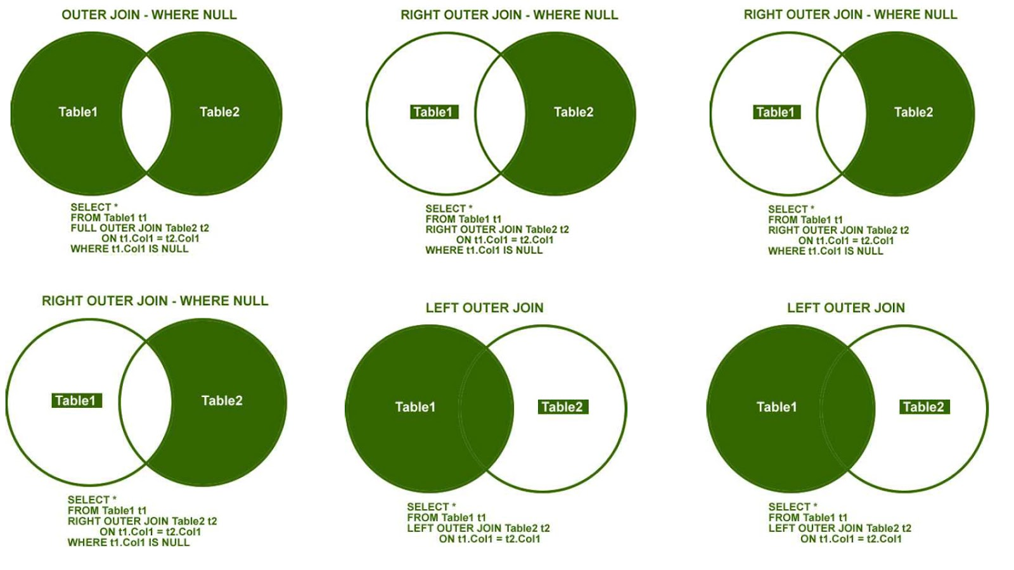
Outer Join of tables options

Slide 17
Join Examples
PROC SQL;
CREATE TABLE BOTH AS
SELECT A.PATIENT,
A.DATE FORMAT=DATE7. AS DATE, A.PULSE,
B.MED, B.DOSES, B.AMT FORMAT=4.1
FROM VITALS A INNER JOIN DOSING B
ON (A.PATIENT = B.PATIENT) AND
(A.DATE = B.DATE)
ORDER BY PATIENT, DATE;
QUIT;
PROC SQL;
CREATE TABLE LEFT AS
SELECT A.PATIENT,
A.DATE FORMAT=DATE7. AS DATE, A.PULSE,
B.MED, B.DOSES, B.AMT FORMAT=4.1
FROM VITALS A LEFT JOIN DOSING B
ON (A.PATIENT = B.PATIENT) AND
(A.DATE = B.DATE)
ORDER BY PATIENT, DATE;
QUIT;

Slide 18
Joint examples
PROC SQL;
CREATE TABLE FULL AS
SELECT A.PATIENT,
A.DATE FORMAT=DATE7. AS DATE, A.PULSE,
B.MED, B.DOSES, B.AMT FORMAT=4.1
FROM VITALS A FULL JOIN DOSING B
ON (A.PATIENT = B.PATIENT) AND
(A.DATE = B.DATE)
ORDER BY PATIENT, DATE;
QUIT;

Slide 19
Set operators
set-operator is one of the following:
proc sql;
title 'ME1 and ME2: OUTER UNION CORRESPONDING'; select * from me1
outer union corr
select * from me2;
INTERSECT <CORRESPONDING> <ALL>
OUTER UNION <CORRESPONDING>
UNION <CORRESPONDING> <ALL>
EXCEPT <CORRESPONDING> <ALL>
proc sql;
title 'Flights from IN_USA and OUT_USA';
select * from in_usa
intersect
select * from out_usa;
proc sql;
title 'ME1 and ME2: OUTER UNION';
select * from me1
outer union
select * from me2;
Except: produces rows that are part of the first query only.
ALL: includes duplicate
Union: produces all unique rows from both queries.
Outer Union: contains all the rows produced by the first table-expression followed by all the rows produced by the second table-expression

Slide 20
Set operator cont.
CORR causes PROC SQL to match the columns in table-expressions by name and not by ordinal position
For example, when performing a set operation on two table-expressions, PROC SQL matches the first specified column-name (listed in the SELECT clause) from one table-expression with the first specified column-name from the other.
If CORR is omitted, PROC SQL matches the columns by ordinal position.

Slide 21

Conclusion
SQL is:
Good and useful
less complex than data step
More efficient both in term of coding and system optimization
Let’s use it

